Slide 1

TO DO APPLICATION…
BY
RAHUL SHASHIKANT VENGURLEKAR

Slide 2

To Do Application…
To Do App is a kind of app that generally used to maintain our day-to-day tasks or list everything that we have to do, with the most important tasks at the top of the list, and the least important tasks at the bottom.
It is helpful in planning our daily schedules.

Slide 3
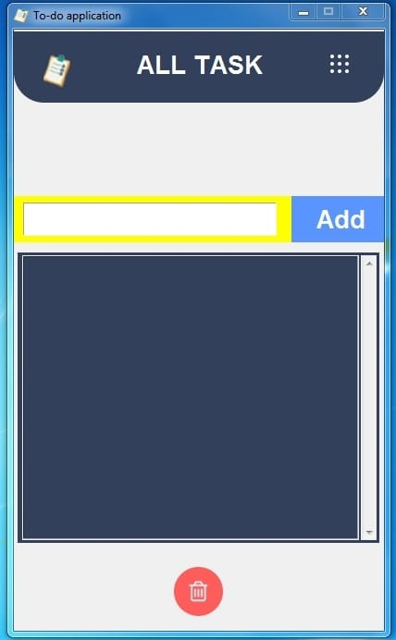
Design
Of
To Do Application…

Slide 4

Module Used In Programme…
Tkinter Programming
Tkinter is the standard GUI library for Python. Python when combined with Tkinter provides a fast and easy way to create GUI applications. Tkinter provides a powerful object-oriented interface to the Tk GUI toolkit.
Tkinter provides various controls, such as buttons, labels and text boxes used in a GUI application. These controls are commonly called widgets.

Slide 5
THANK
YOU
......

